Slide 1
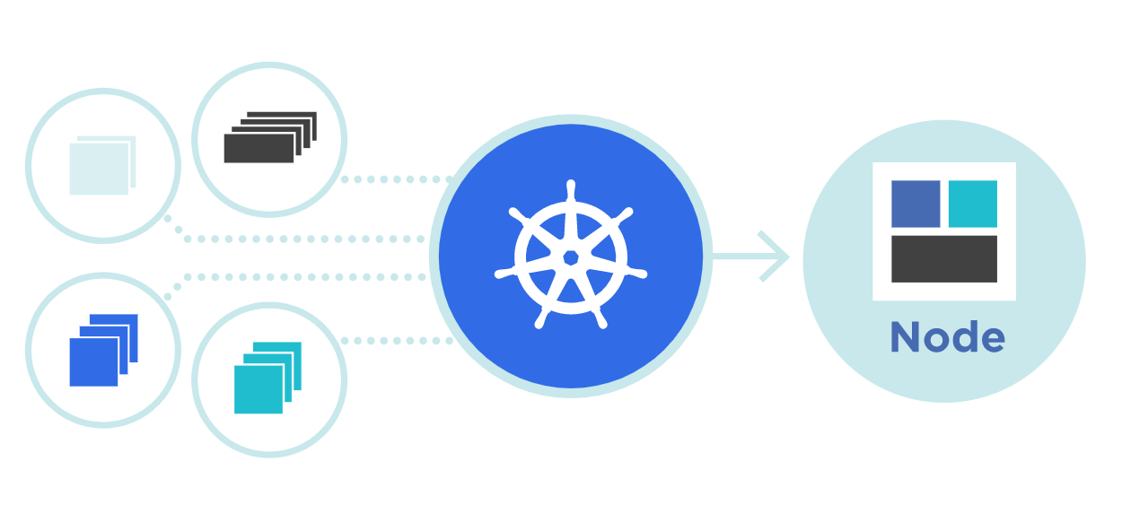

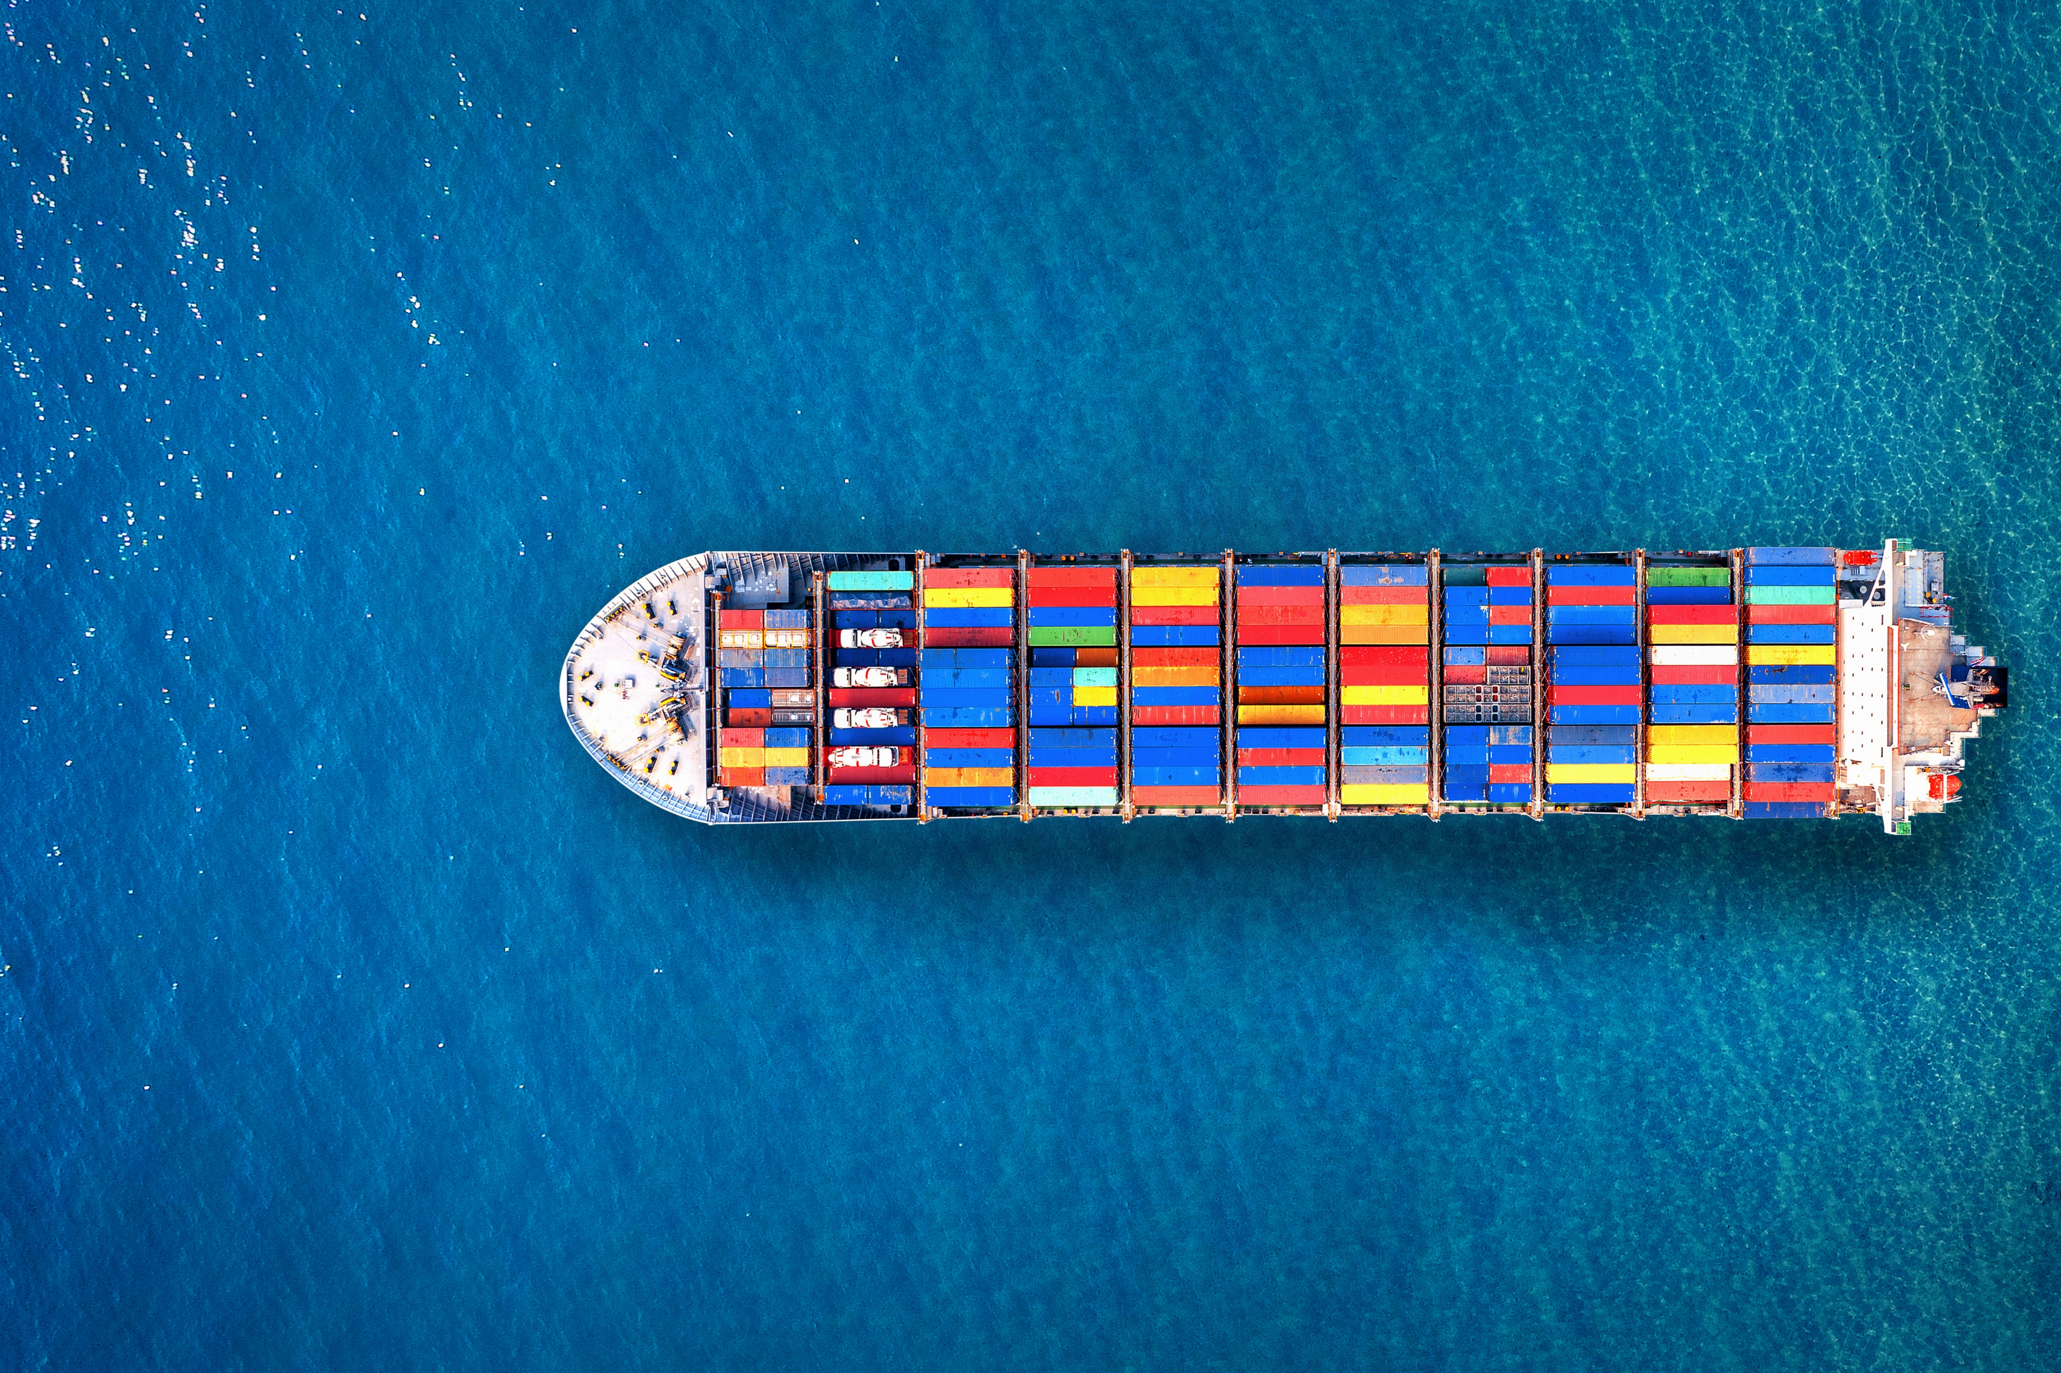

Kubernetes
Cluster Upgrade
Theory + LAB + Documents ➔ All free
WATCH NOW
Notes:
Hello everyone. My name is Anish Rana and you are watching Kubernetes web series.
In this video, I will show you how we can upgrade our Kubernetes cluster.

Slide 2
Master Node
Worker Node
kubeadm
kubeadm
kubelet
kubelet
kubectl
kubectl
Kubernetes cluster

Slide 3
High level view for upgrade Kubernetes cluster
Upgrade kubeadm
Plan the upgrade (kubeadm upgrade plan)
Upgrade the node (kubeadm upgrade apply)
Drain the node (kubectl cordon node_name )
Upgrade kubelet & kubectl
Restart the kubelet (systemctl daemon-reload ; systemctl restart kubelet)
undrain the node (kubectl uncordon node_name)

Slide 4
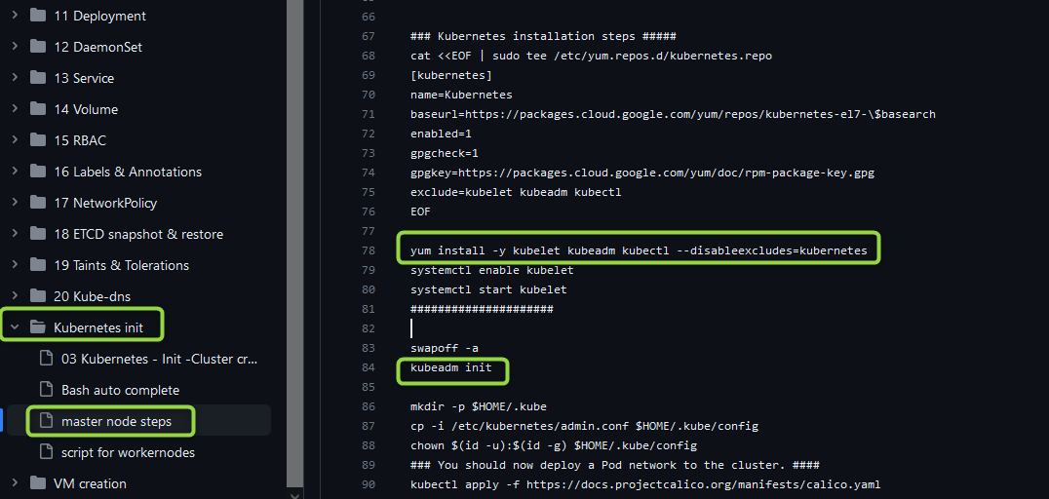
kubeadm
Kubeadm is a tool that provide "kubeadm init" for creating Kubernetes clusters and "kubeadm join" to join the workernode to master node.

Slide 5
Kubelet
Kubelet is an agent, which runs on each workernodes.
When we attach the worker node with Master node, this kublet will help us.
The Kubelet is responsible for managing the deployment of pods to Kubernetes nodes.
How many resources a POD is required, it will get it from Node.
It receives commands from the API server and instructs the container runtime to start or stop containers as needed.

Slide 6
kubectl
The Kubernetes command-line tool, kubectl, allows you to run commands against Kubernetes clusters.
You can use kubectl to deploy applications, inspect and manage cluster resources, and view logs.

Slide 7
High level view for upgrade Kubernetes cluster
Upgrade kubeadm
Plan the upgrade (kubeadm upgrade plan)
Upgrade the node (kubeadm upgrade apply)
Drain the node (kubectl cordon node_name )
Upgrade kubelet & kubectl
Restart the kubelet (systemctl daemon-reload ; systemctl restart kubelet)
undrain the node (kubectl uncordon node_name)

Slide 8
v1.25
v1.24
v1.23
Apiserver
Scheduler
controller-Manager
Kubelet
Kube-Proxy
kubectl

Slide 9
05 NOW WE WILL TALK ABOUT
LAB

Slide 10
Kubernetes Cluster Upgrade ☺
by Anish Rana @anishrana2001
Theory + Lab + Document + CKA
https://paypal.me/anishrana20011

